Slide 1
CIS387/ECE387
Digital Forensics I
Linux and Macintosh File Systems

Slide 2
Reading
Ch7: Guide to Computer Forensics and Investigations, 5th edition, by Bill Nelson, Amelia Phillips, Christopher Steuart.
Notes:
In context of computer forensics, we want to learn how ….
To do so, in this lecture, we try to under

Slide 3
Objectives
Describe Linux file structures
Describe Macintosh file structures
Use Linux forensics tools

Slide 4
Examining Linux File Structures
UNIX flavors (distributions)
  Silicon Graphics, Inc. (SGI) IRIX, Santa Cruz Operation (SCO) UnixWare, Sun Solaris, IBM AIX, and HP-UX
Linux distributions (Kernel is the same = Linux OS)
  Ubuntu, Debian, Red Hat, OpenSUSE, and Slackware
  Linux is only the core of the OS
All UNIX-like OSs have a kernel
Notes:
Linux file system derived from Unix
Unix was especially popular in 1980s (for main frames and graphic work stations)
Especially used for computer aided design.

Slide 5
History
EXT or “Extended” file system was introduced in 1992 to replace the Minux file system in Linux.
EXT2 was very successful. Still used on removable media.
EXT3 (2001) added journaling to provide better crash recovery.
EXT4 (2006) added more capacity and better performance. It is now the default file system for many Linux distributions.
Notes:
4 major versions of Linux file systems as shown above…

Slide 6
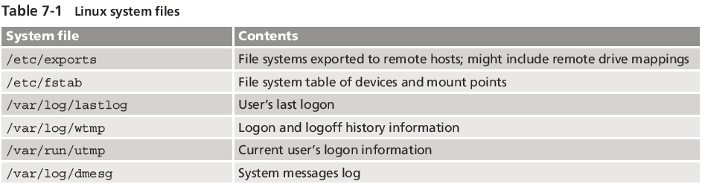
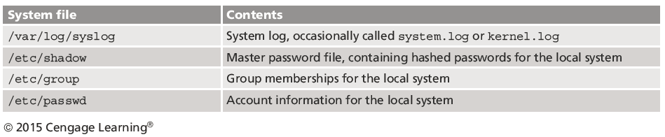
Examining Linux File Structures
Notes:
Log files are in plaintext for Linux.
For Windows, the logs of the systems are stored in registry.
When you log in, your password is hashed and checked against the /etc/shadow file under the username you are logging on as….so even system administrator who has access to the etc shadow file will not be able to know the password of the user since it is hashed.

Slide 7
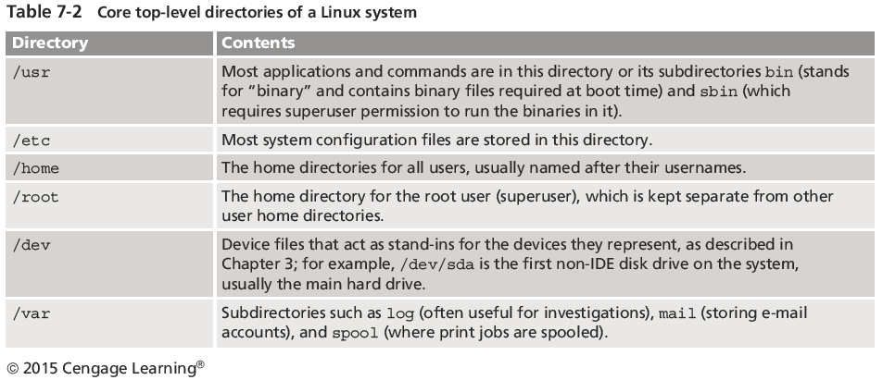
Examining Linux File Structures
Notes:
Dev is where drives (hard drive, flash drives, removable drives…etc.) are stored logically as a file.

Slide 8
Examining Linux File Structures
Remember that UNIX and Linux commands are case sensitive
  Wrong capitalization can mean your commands are rejected as incorrect or interpreted as something different
Review some Linux commands by working through the activity on the textbook
Notes:
For windows, commands are not case sensitive.

Slide 9
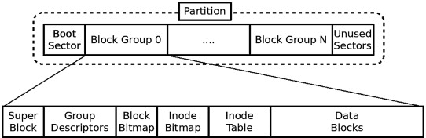
File Structures in Ext4
Improved management of large files and offered more flexibility
Support volumes with sizes up to 1 exbibyte (EiB) and single files with sizes up to 16 tebibytes (TiB) with the standard 4 KiB block size.
Notes:
Number of inodes and blocks of the block group is fixed, and so we have bit maps for each of them to tell whether the block or inode is allocated or not.
Remember block = cluster.

Slide 10
File Structures in Ext4
Boot block
  Block is a disk allocation unit of at least 512 bytes
  Contains the bootstrap code
  UNIX/Linux computer has only one boot block, located on the main hard disk
Notes:
Equivalent to the NTFS $boot system file.

Slide 11
File Structures in Ext4
Superblock
  Indicates disk geometry, available space (number of blocks in the group that are being used), and location of the first inode
  Manages the file system
Inode blocks
  First data after the superblock
  Assigned to every file allocation unit
Data blocks
  Where directories and files are stored
  This location is linked directly to inodes
Notes:
inode = index node → contains metadata for a file.
Similar to the MFT record (from NTFS file system) except that inside inode there are no file names (file name is stored only inside. directory files).
Pointer to the inode (metadata) for the file and the file name is stored inside of the directory file to which the file belongs.

Slide 12
Inodes
Contain file and directory metadata
  Also link data stored in data blocks
An assigned inode contains the following:
  Mode and type of file or directory
  Number of links to a file or directory
  UID and GID of the file’s or directory’s owner
  Number of bytes in the file or directory
  File’s or directory’s last access time and last modified time
Notes:
Remember in EXT, a file can be hard-linked to multiple directories.
This hard link is not the same as the soft link (software link or symbolic links) such as shortcut files in Windows.
Note: if the number of links > 1, then if any directory is deleted that is linked to a file, the file will not be deleted but rather number of links is decremented by 1; it is only deleted when all directories linked to the file is deleted (or of course if the file itself is deleted).
UID = user ID
GID = Group ID
Another note: NTFS does support both hard links and soft links (symbolic links).
Time stamps is 64 bits for EXT-4, so you can get time stamps with accuracy up to the nanosecond.

Slide 13
Inodes
An assigned inode contains the following (cont’d):
  Inode’s last file status change time
  Block address for the file data
  Indirect, double-indirect, and triple-indirect block addresses for the file data (only used by EXT-2 and EXT-3)
  Current usage status of the inode
  Number of actual blocks assigned to a file
  File generation number of version number
  Continuation inode’s link

Slide 14
Block Mapping (EXT2&3)
First inode has 13 pointers
  Pointers 1 to 10 are direct pointers to data storage blocks
Pointer 11 is an indirect pointer
  Links to 128 pointer inodes and each pointer links directly to 128 blocks
  Pointer 12 is a double-indirect pointer
  Pointer 13 is a triple-indirect pointer

Slide 15
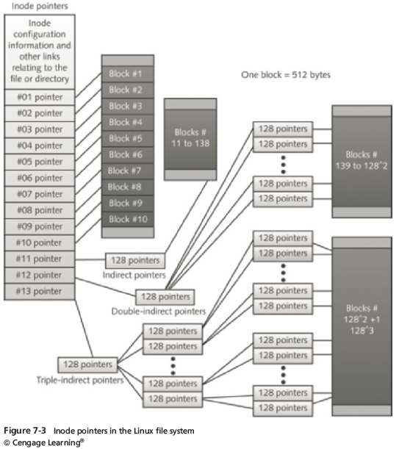
Inodes (only EXT-2 and EXT-3 use this structure with inodes shown below)
Notes:
So max amount of blocks that can be allocated to a file is : (10 + 128 + 128^2 + 128^3)
Disadvantage of this structure: for large files you will have to do multiple reads (of pointers) before finally reaching some blocks.
For NTFS and EXT-4, they overcome this problem with large files because NTFS uses cluster runs and does not require so many pointers to be accessed to read/write to large files.
See next slide to see how EXT-4 overcomes the above inefficiency described/shown.

Slide 16
Extents (EXT4)
Instead of represent each block, represent large contiguous chunks of blocks with an extent
An extent is a range of contiguous physical blocks, improving large-file performance and reducing fragmentation. A single extent in ext4 can map up to 128 MiB of contiguous space with a 4 KiB block size.
There can be four extents stored directly in the inode. When there are more than four extents to a file, the rest of the extents are indexed in a tree.

Slide 17
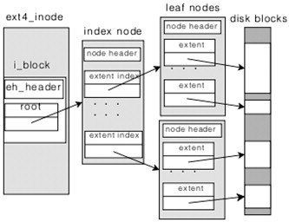
Notes:
Very similar to cluster run concept from NTFS.
It is still different from NTFS cluster run because it can still form a tree just like EXT-2 and EXT-3 if file is large enough, but it still helps allow for larger files without as many pointers, however the same issue can still happen if files become large enough.

Slide 18
Inodes
Bad block inode
  Keeps track of disk’s bad sectors
To find bad blocks on a Linux computer, use the following commands
  badblocks - must log in as root to use
  mke2fs and e2fsck - include safeguards that prevent them from overwriting important information

Slide 19
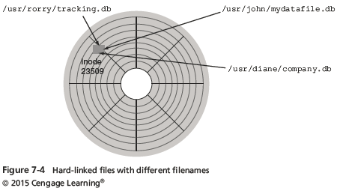
Hard Links and Symbolic Links
Hard link
  A pointer that allows accessing the same file by different filenames
  Use the ln command to create a hard link
Notes:
You can tell if two directories point to the same file by looking at the inode pointer; if the inode pointer associated with the file in both directories is the same, then you know the file has a hard link to both directories. Inode pointer is key because the file can be named differently in in each directory to which it is linked (remember file name of a file is only stored in the directory), but the inode pointer will be the same since the file is really the same (remember, directory files store the file name and inode pointer for each of its files).

Slide 20
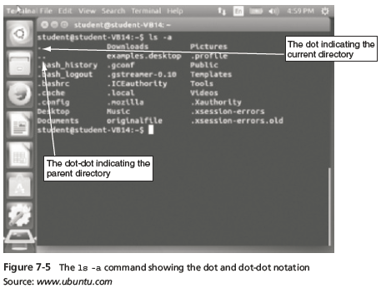
Hard Links and Symbolic Links
Link count
  A field inside each inode that specifies the number of hard links

Slide 21
Hard Links and Symbolic (soft) Links
Symbolic links
  Pointers to other files and aren’t included in the link
  Also known as “soft links” or “symlinks”
  Can point to items on other drives or other parts of the network
  Have an inode of their own
    Not the same as the inode of the item they are pointing to
  Depend on the existence of the destination they are pointing to
Notes:
Soft links is similar to windows shortcut files.
It is a separate file, but its content is linked (points to) another file without having the property of increasing number of links to the file, so if you delete the shortcut file, the primary file storing its contents will not be affected. However, if you delete, move, or rename the primary/original file, then the soft link file will have a pointer that is invalid. The main difference is that soft links do not have the property of affecting number of links to the file and the original file (and file system) is not aware (or does not associate) of the soft link pointing to it.
Soft link files can point to anywhere and originate (be created) anywhere.
Hardlinks require that the directories be a part of the same volume/partition of the file.

Slide 22
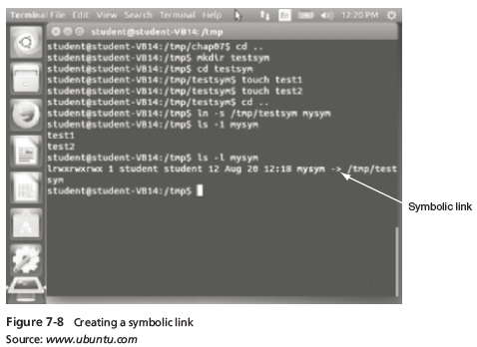
Hard Links and Symbolic Links

Slide 23
File permissions
types : read (r), write (w), execute (x)
people : owner (u), group (g), others (o)
  permissions are shown when you type ls -l
  is it a directory?
  owner (u)
  group (g)
  others (o)
  drwxrwxrwx
command | description
chmod | change permissions for a file
umask | set default permissions for new files
Notes:
Remember: Linux is derived from UNIX, so user access control is very important.

Slide 24
Setuid/Setgid Special Permissions
The setuid/setguid permissions are used to tell the system to run an executable as the owner with the owner’s permissions.
Be careful using setuid/setgid bits in permissions. If you incorrectly assign permissions to a file owned by root with the setuid/setgid bit set, then you can open your system to intrusion.
The character for the setuid/setguid bit is s.
So do set the setuid/setguid bit on file2.sh you would issue the command chmod g+s file2.sh.
Notes:
If you want to give all users same permissions to users →chmod 777 filename.txt == 111 111 111 → rwx rwx rwx → user group others all have rwx permissions.
You cannot have execute permissions without reading, so if you want to give execute permissions, read must also be granted.
Another Example of file permissions: rwsr-sr-x → doing g+s causes x to be replaced with s, and s simply means you can execute a file with owner privileges (this is important for things such as allowing a user to change their password).

Slide 25
Sticky Bit Special Permissions
The sticky bit can be very useful in shared environment because when it has been assigned to the permissions on a directory it sets it so only file owner can rename or delete the said file.
You can only assign the sticky bit by explicitly defining permissions. The character for the sticky bit is t.
To set the sticky bit on a directory named dir1 you would issue the command chmod +t dir1.

Slide 26
Using Linux Forensics Tools
Most commercial computer forensics tools can analyze Linux Ext2, Ext3, Ext4, ReiserFS, and Reiser4 file systems
Freeware tools include Sleuth Kit and its Web browser interface, Autopsy Forensic Browser

Slide 27
Understanding Macintosh File Structures
MAC OS X is built on a core called Darwin
  Consists of a Berkeley Software Distribution (BSD) UNIX application layer
With OS X, Macintosh moved to the Intel processor and become UNIX based
macOS Ventura – version 13, 2022
Based on the core of macOS, iOS for its iPhone, iPad, iPod Touch and HomePod smart speakers; watchOS for the Apple Watch; tvOS in 2015 for the Apple TV set-top box.
Notes:
Most companies focus on software or hardware.
Apple is the only company that is “vertically integrated” → meaning they develop and implement/design/manufacture the hardware and software for their machines.
Almost went bankrupt in 1990
In 2022 it is now one of the biggest companies in the world in terms of market value.
Used PowerPC for a long time, then switched to x86 architecture; now the desktops and laptops have moved to ARM(M1, M2) architectures.
ARM is same architecture used for mobile phones, most laptops, and tablets.
X86 (CISC = complex (variable length) instruction set computer) and ARM (RISC = reduced instruction set computer) are competing architectures.
RISC architectures are more energy efficient and instructions can be completed in one CPU cycle –> but more instructions have to be executed since they are not as complex.
X86 is developed by both Intel and AMD; but X86 is losing the battle against ARM.

Slide 28
Understanding Macintosh File Structures
Before OS X, Hierarchical File System (HFS)
  Files stored in nested directories (folders)
Extended Format File System (HFS+)
  Introduced with Mac OS 8.1
  Supports smaller file sizes on larger volumes, resulting in more efficient disk use
Apple File System (APFS), introduced in 2016, is optimized for flash and solid-state drive storage, with a primary focus on encryption (many devices have hardware acceleration so that encryption and decryption performance is so fast you will not notice any difference).

Slide 29
APFS Main Features
Space sharing between volumes
Clones (copy on write → similar to hardlink copy, except any changes made to the clone are written to different location while still sharing any intact cloned file data)
Snapshots (copy on write; same idea as clones, but instead entire file system is cloned)
Full disk encryption and single-file encryption
Increased maximum number of files (2^63)
Increased granularity of timestamps (was 32 bits = 1 sec, now 64 bits = nanoseconds)
Data integrity for metadata (uses CRC)
Compression
Sparse file
Notes:
Can create multiple volumes in one container(disk) (and size of each volume partition size is not fixed → they can grow as needed).
For Windows, once you do a partition, the volume size is fixed.
Clones (copy on write → hardlink copy, except any changes made to the clone are written to different location while still sharing any intact cloned file data)
Just create a separate inode (metadata) for the cloned file and clone-link it to the file to be cloned.
This allows you to save space and time because you only have to write when changes are made to the cloned file so that the file that was cloned remains intact/unchanged.
It is basically a temporary clone of a file because once the cloned file is changed it will no longer be an exact copy of original file.
Previously inode values could only be 2^31 values; now using 63 bits there can be 2^6 inodes = max number of files = increased file system sizes.
Some applications can take advantage of a file system with more accurate (granular) time stamps.

Slide 30
APFS Limitations
Performance on hard disk drives
Limited integrity checks for user data
Security issues (on permissions; but these issues are mostly fixed)
Notes:
Tests were ran on old machines that users installed APFS and found that it was really slow performance (because old machines only used disk drives).
In older file system, inodes stay together with data blocks in APFS, which causes better performance for disk drives; but AFPS has inodes and data areas mixed (an inode does not have to be directly before its corresponding data) so that on a disk drive performance is much slower for sequential access or searching through directories for files.

Slide 31
Forensics Procedures in Mac
There are some differences between Linux and Mac OS X file systems
  Linux has the /home/username and /root directories
  In Mac, the folders are /users/username and /private/var/root
  The /home directory exists in the Mac OS but it is empty
  Mac users have limited access to other user accounts’ files and the guest account is disabled

Slide 32
Forensics Procedures in Mac
For forensics procedures in Mac OS X:
  You must know where file system components are located and how both files and file components are stored
Application settings are in three formats:
  1) Plaintext, 2) plist files, and the 3) SQLite database
  Plist files are preference files for installed applications on a system
FileVault is used to encrypt and decrypt a user’s /users directory (saves time because other system files may not be necessary to encrypt)
Notes:
Files in home directory that start with . Are configuration files, which are just plaintext files.
There different application setting formats allow for improved performance versus just only the plaintext option for files (Linux only supports plaintext).

Slide 33
Forensics Procedures in Mac
Keychains
  Encrypted Files used to manage passwords for applications, Web sites, and other system files
  The Mac application Keychain Access enables you to restore passwords
Deleted files are in the Trashes folder
  If a file is deleted at the command line, however, it doesn’t show up in the trash (only shows in trash if you delete using GUI)
Notes:
Keychain files can also be stored on iCloud.
Keychain is similar to how browsers store passwords and cookies, but it is more secure.

Slide 34
Forensics Procedures in Mac
Tools and vendors
  BlackBag Technologies Macintosh Forensic Software (OS X only)
  SubRosaSoft MacForensicsLab (OS X only)
  Guidance EnCase
  X-Ways Forensics
  AccessData FTK

Slide 35
Summary
UNIX was created to be a multiuser, multithreaded, secure OS
The Linux kernel is usually packaged with other software components, such as a GUI and applications
Linux supports a wide range of file systems
UNIX and Linux have four components defining the file system: boot block, superblock, inode block, and data block

Slide 36
Summary
In the Linux file system, a hard link is a pointer that allows accessing the same file by different filenames
Mac supports several file systems HFS, HFS+ , and APFS
The biggest challenge in acquiring images from Mac systems is often physical access to the drive (they make it hard to remove harddrive on mobile devices without damaging the drive)

